Slide 1

Communication
Unit 8

Slide 2

Opener

Slide 3
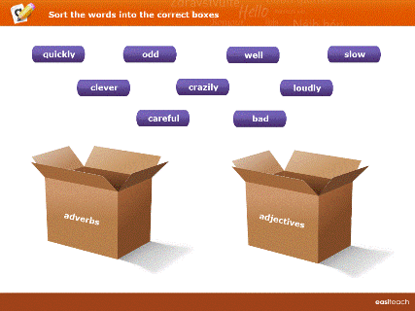
Sort the words into the correct boxes.

Slide 4
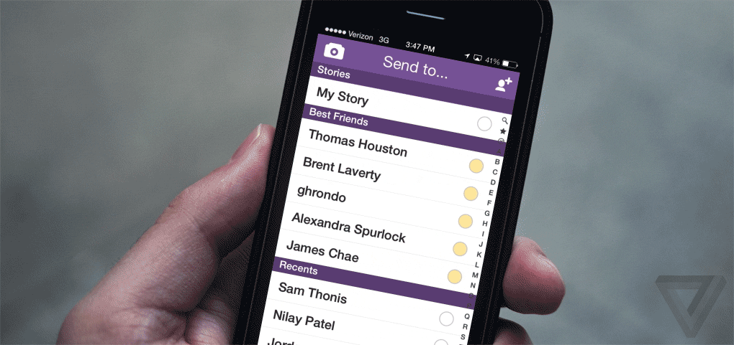
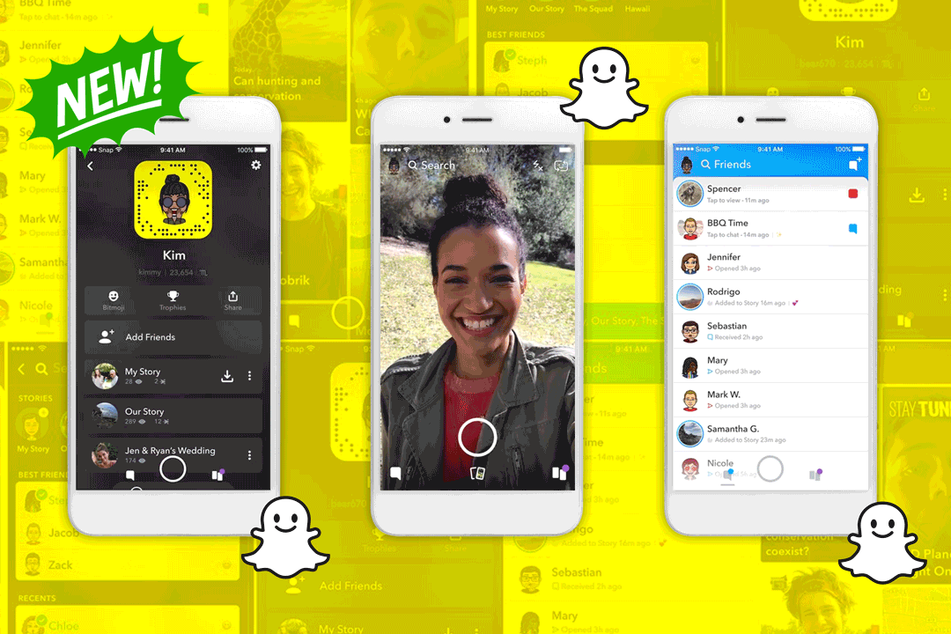
How do people communicate nowadays?

Slide 5
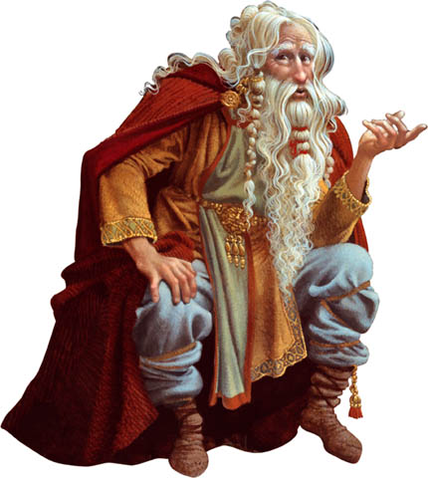
How did people communicate in the past?
*By telling stories and facts to younger generation.
*By carving and painting on stones
*By writing.

Slide 6

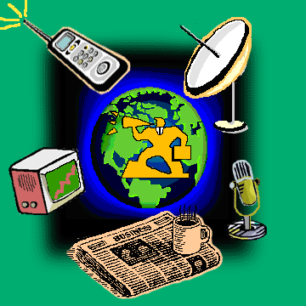
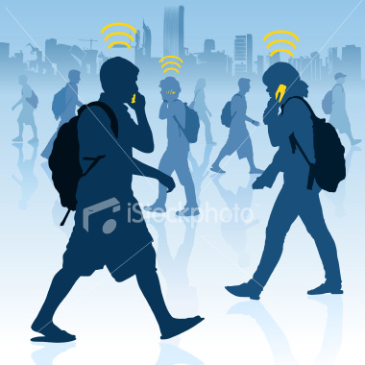

Slide 7
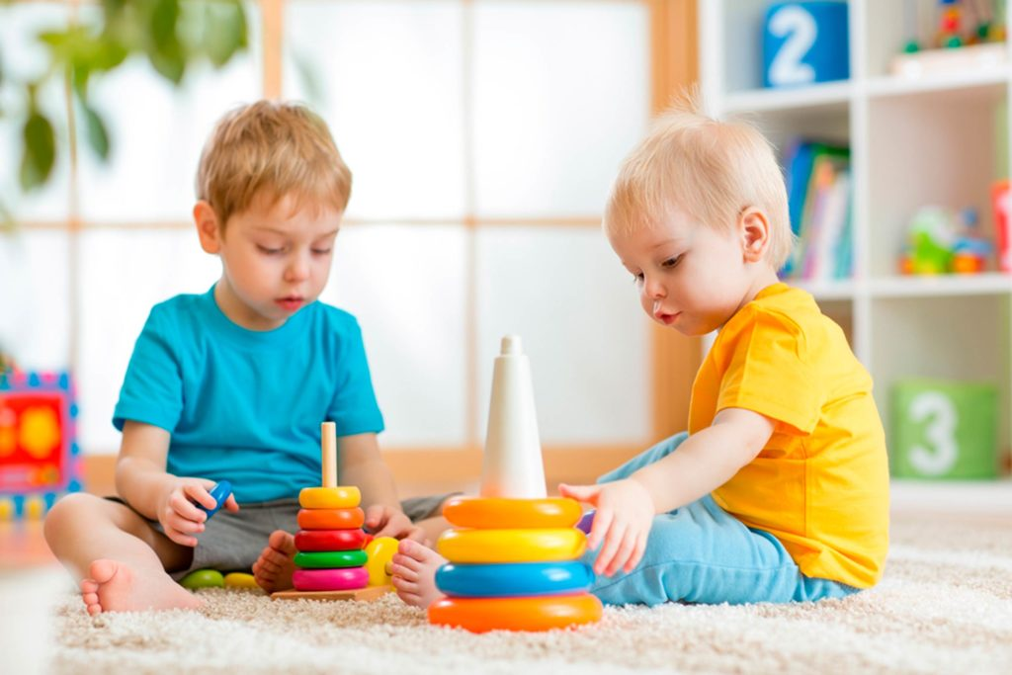

Slide 8
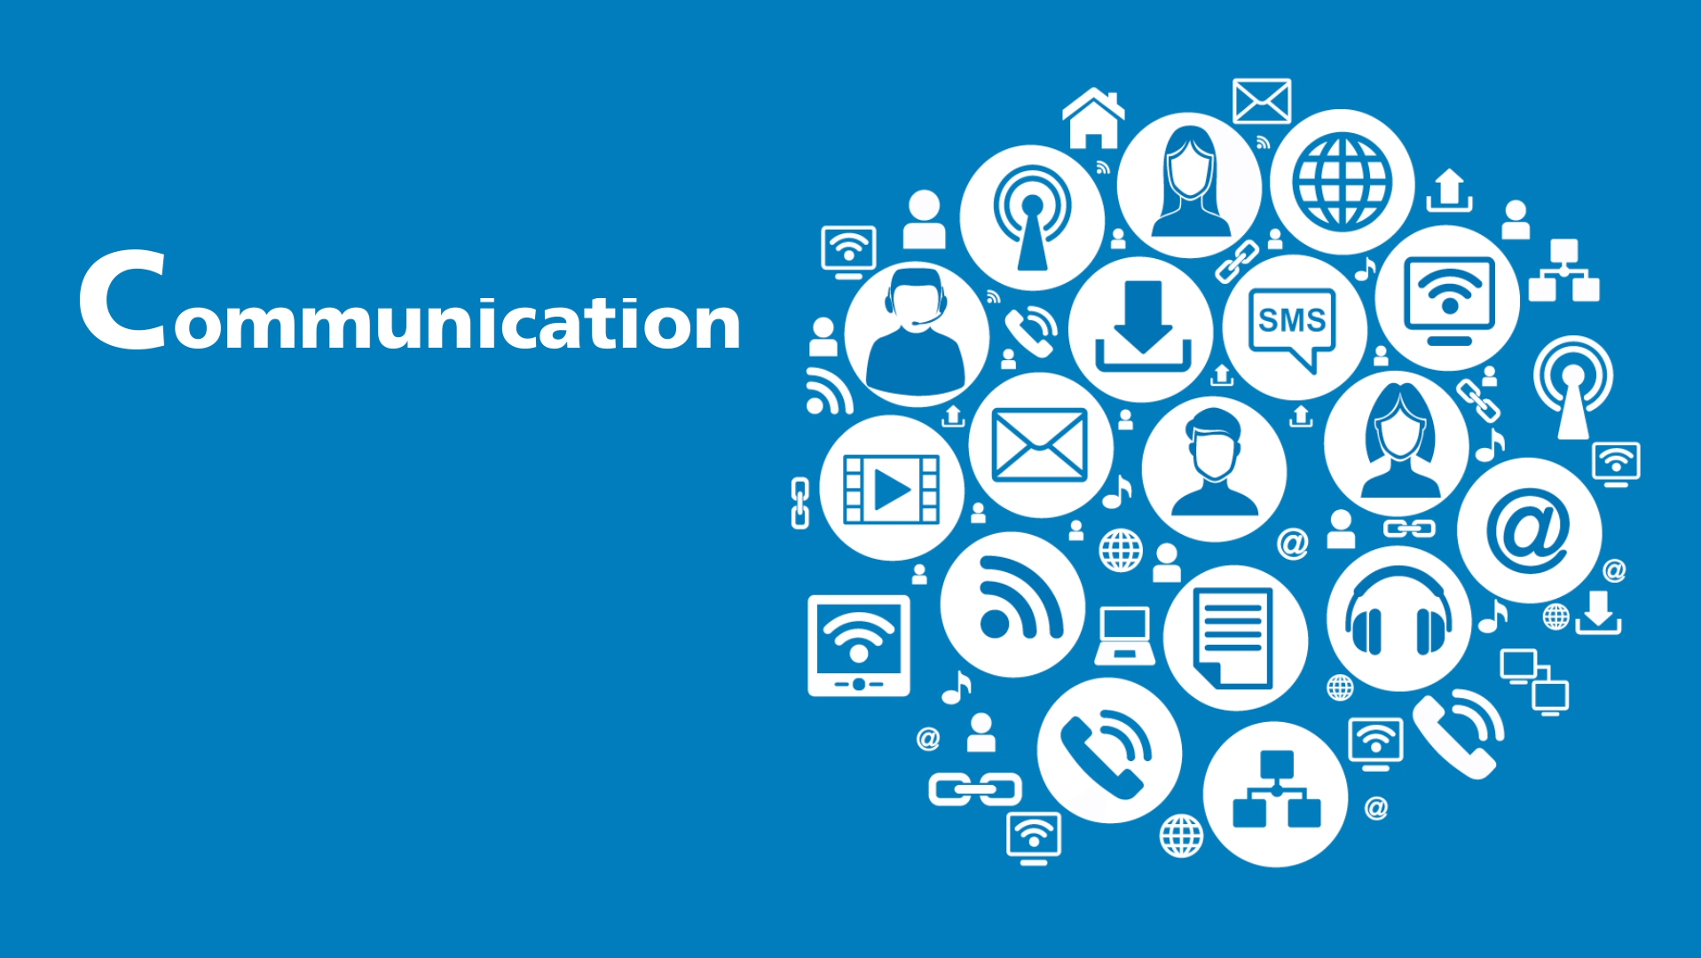
How do you usually communicate with your friends?

Slide 9
Do you think that communication is important? How?
People can share their thoughts and ideas through communication.

Slide 10
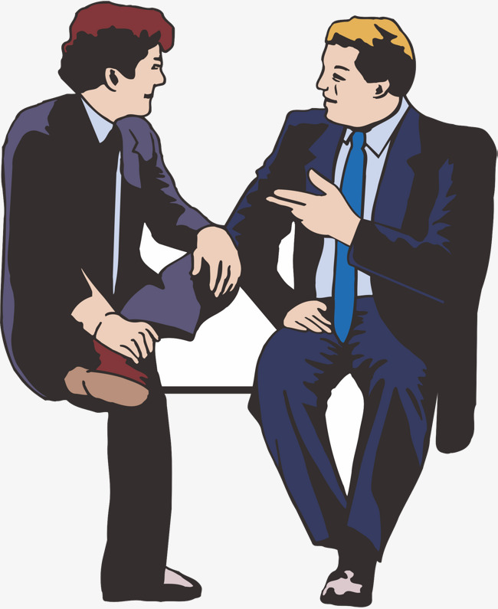
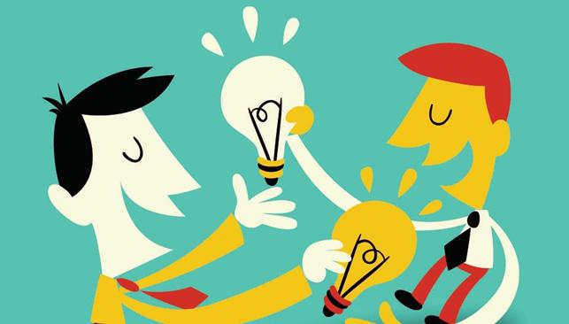
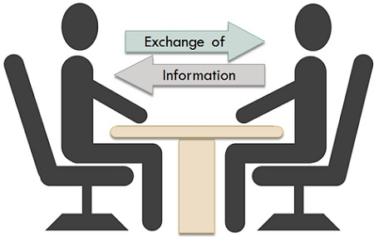
People can exchange their information and ideas through communication.

Slide 11



exchange
to discuss something or share ideas, information

Slide 12
Communication helps us convey information, ideas, feelings and opinions. .

Slide 13
convey
to express a thought, feeling, or idea so that it is understood by other people

Slide 14
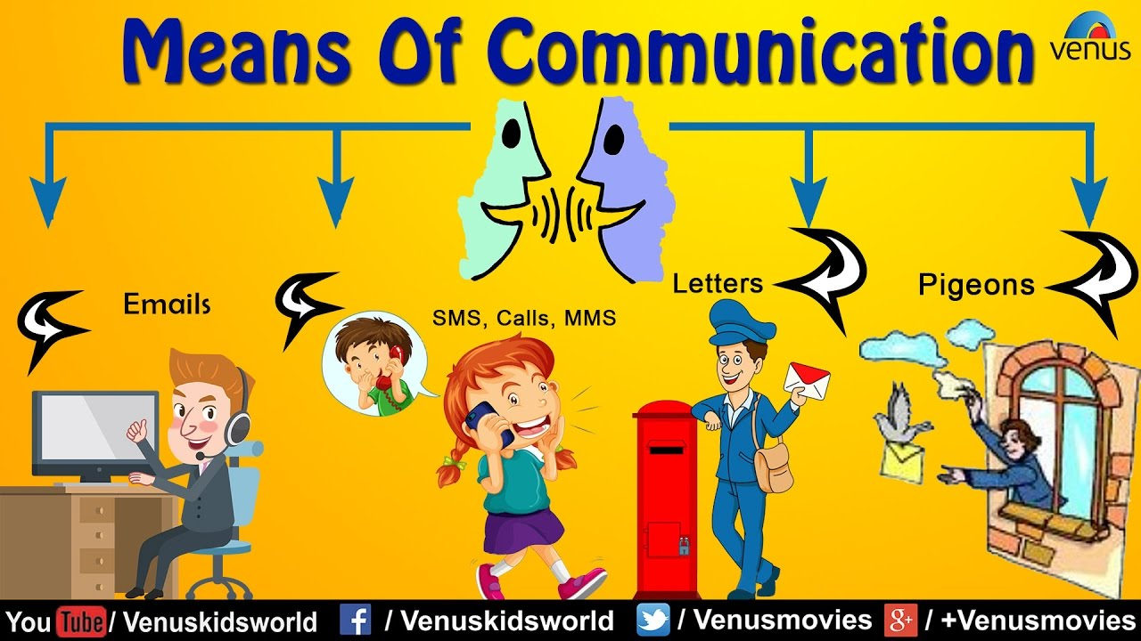
The ways people communicate have changed gradually.

Slide 15
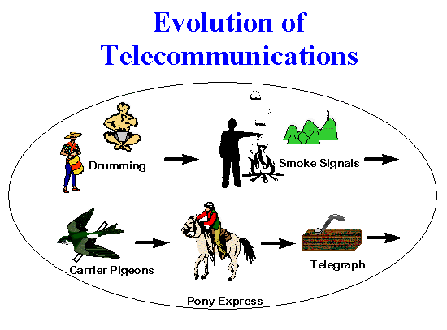
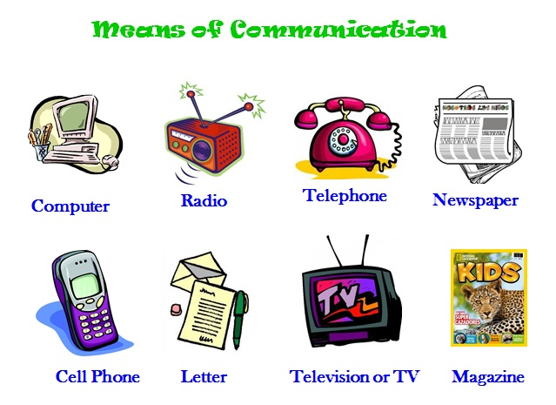
gradually
slowly over a period of time or a distance

Slide 16
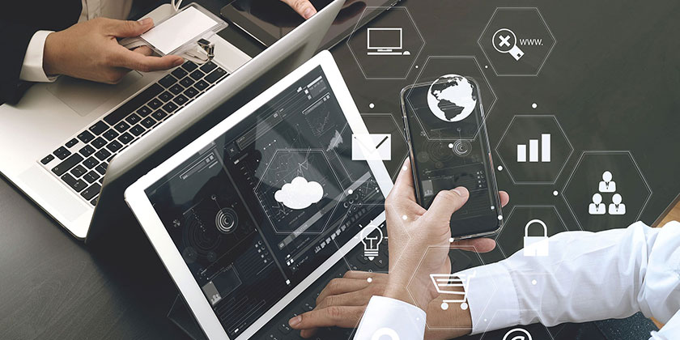
Now, communication happens much more efficiently.

Slide 17
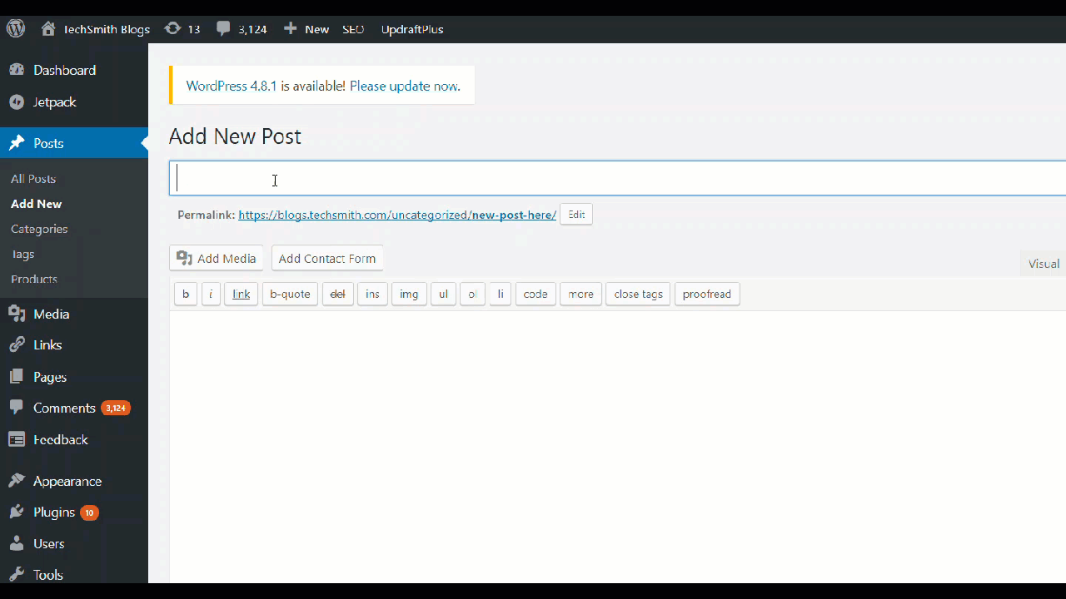
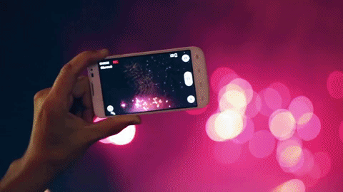
efficiently
working quickly and effectively in an organised way

Slide 18
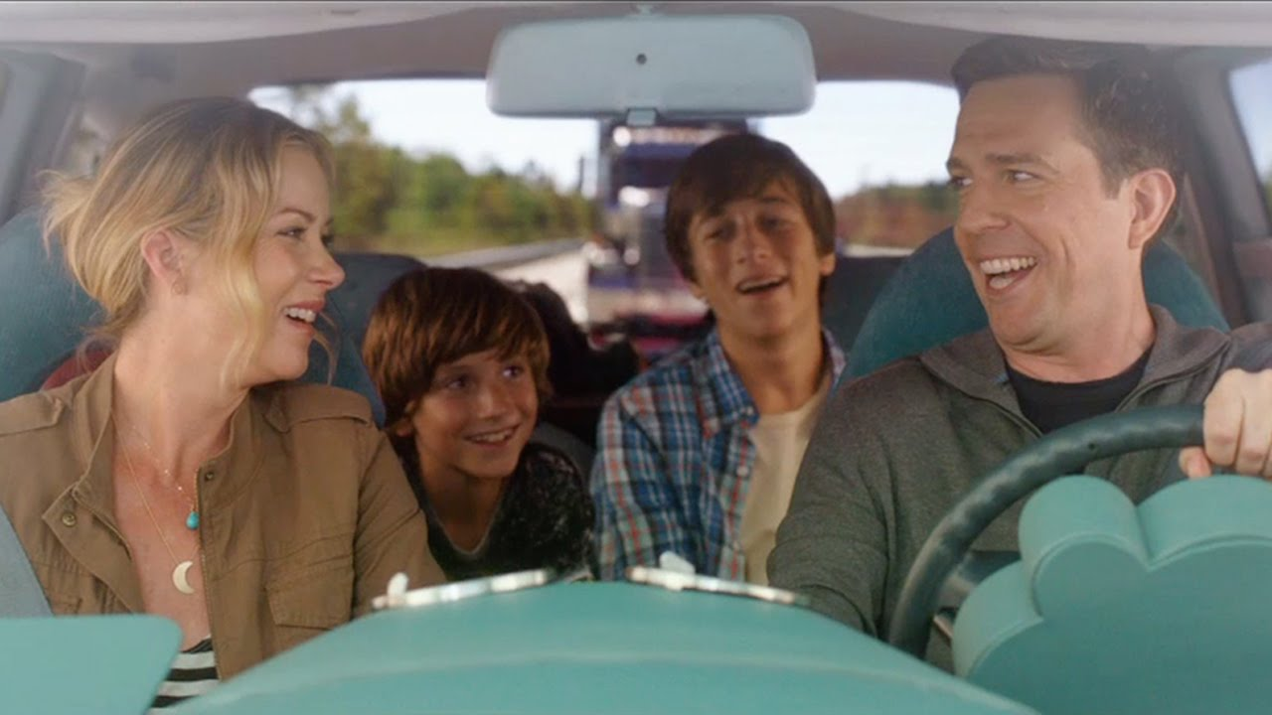

However, we must talk to people face to face because meeting in person allows us to show our true feelings and reactions.

Slide 19
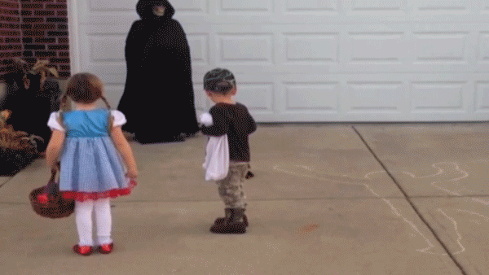
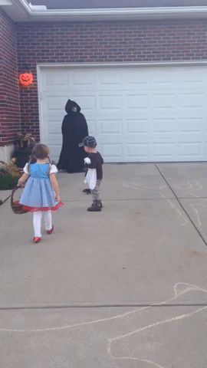
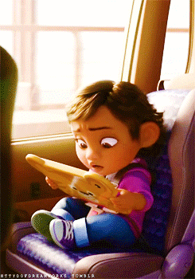
reaction
behaviour, a feeling or an action that is a direct result of something else

Slide 20
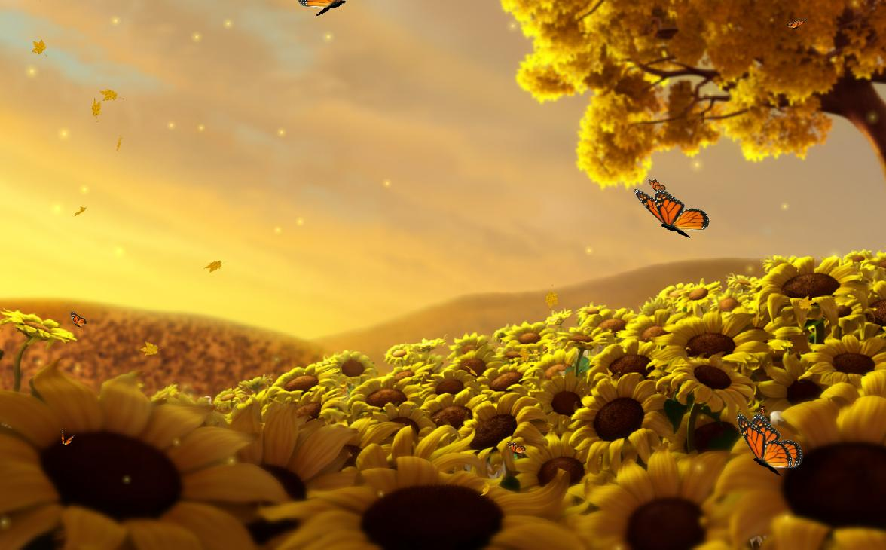
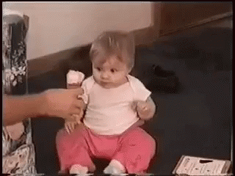
New
Vocabulary

Slide 21

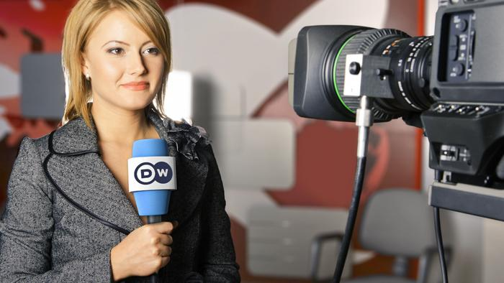
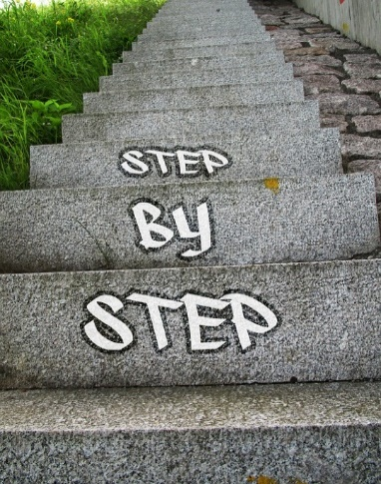


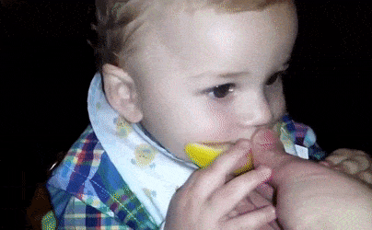
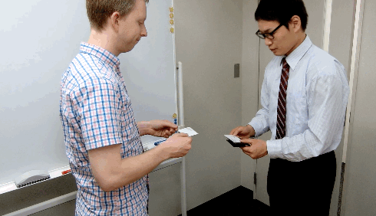
convey (v.)
gradually (adv.)
exchange (v.)
efficiently (adv.)
reaction (n.)

Slide 22
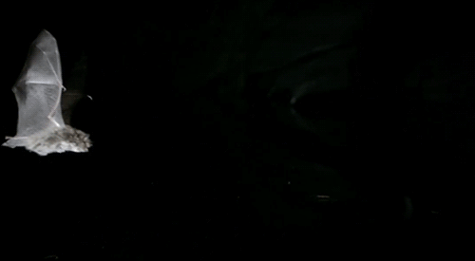

Student’s Book
Page 63

Slide 23
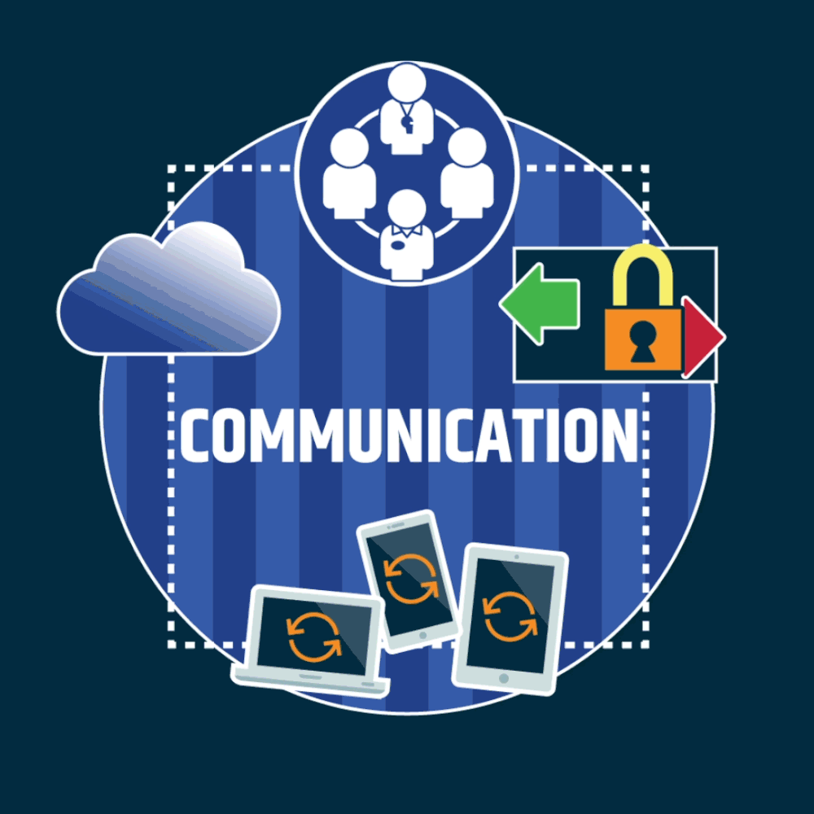


Slide 24



Slide 25
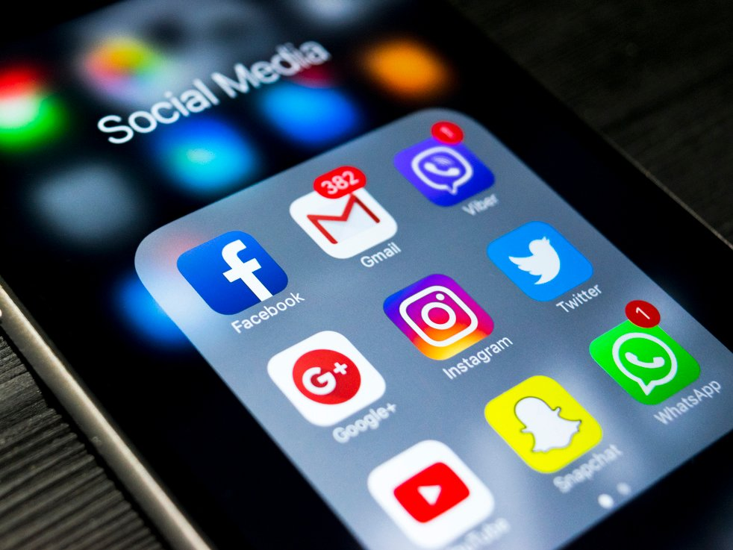

Check your answers.

Slide 26




Read the text and match the paragraphs with their headings:
Paragraph 1 ( ) Modern communication
Paragraph 2 ( ) Communication in the Past
Paragraph 3 ( ) The importance of Communication
Paragraph 4 ( ) Development of Communication

Slide 27

Student’s Book
Page 64

Slide 29

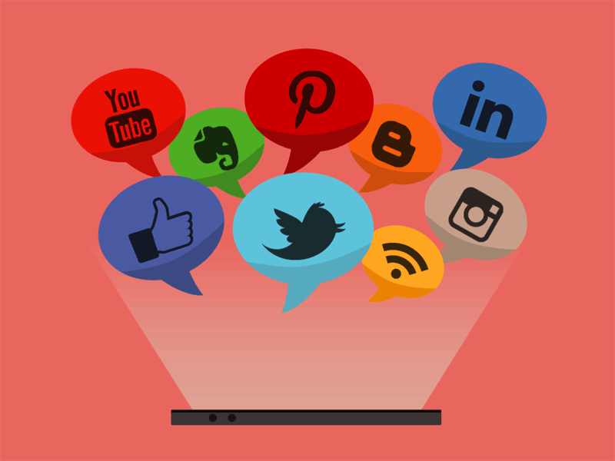
Check your answers.

Slide 30

Why is communication important?
Communication helps us convey information, ideas, feelings and opinions.

Slide 31
• What was the main source of information in the past?
Oral culture was the main source of information in the past.

Slide 32
• Explain how technology has made communication easy and fast.
We can watch news stories from all over the world, learn facts and information and talk to our families and friends even from miles away.

Slide 33
• Why should we talk to people face to face?
We should talk to people face to face because communication is more than just words. Meeting in person allows us to show our true personalities, emotions and reactions.

Slide 34
• What is the author's purpose for writing this text?
The author’s purpose for writing this text is to show the importance of communication.

Slide 35



• Identify the topic sentence, the supporting details and the concluding sentence in the third paragraph.

Slide 36
• Identify the topic sentence in the third paragraph.
The inventions of printing, telephone, radio, television and computer in the last century changed the way we communicate.

Slide 37
• Identify the supporting details.
• Nowadays, we get a lot of our information from the Internet.
• Today, communication satellites send signals across the globe.
• Consequently, we can experience world events as they happen.

Slide 38
• Identify the concluding sentence.
Now, communication happens much more efficiently.

Slide 39
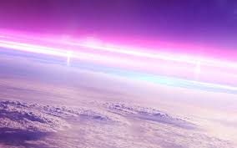


Slide 40
We all have ideas, feelings and opinions that we want to communicate to other people. Communication helps us convey information, but the process of human communication has improved over the years as the ways we communicate have changed gradually. Oral culture was very important in the past. People had to store all their knowledge in their memories before writing was invented.

Slide 41
Older people told stories and facts to the younger generations. Later, people learned to carve and paint pictures on stones. They used these to exchange ideas. After writing was invented, people were able to write down everything they knew.

Slide 42
The inventions of printing, telephone, radio, television and computer in the last century changed the way we communicate. Nowadays, we get a lot of our information from the Internet. Today, communication satellites send signals across the globe. Consequently, we can experience world events as they happen. Now, communication happens much more efficiently.

Slide 43
Today’s technology has made communication faster and easier. We can watch news stories from all over the world, learn facts and information and talk to our families and friends even from miles away. However, we must remember to talk to people face to face because communication is more than just words. Meeting in person allows us to show our true personalities, emotions and reactions.

Slide 44

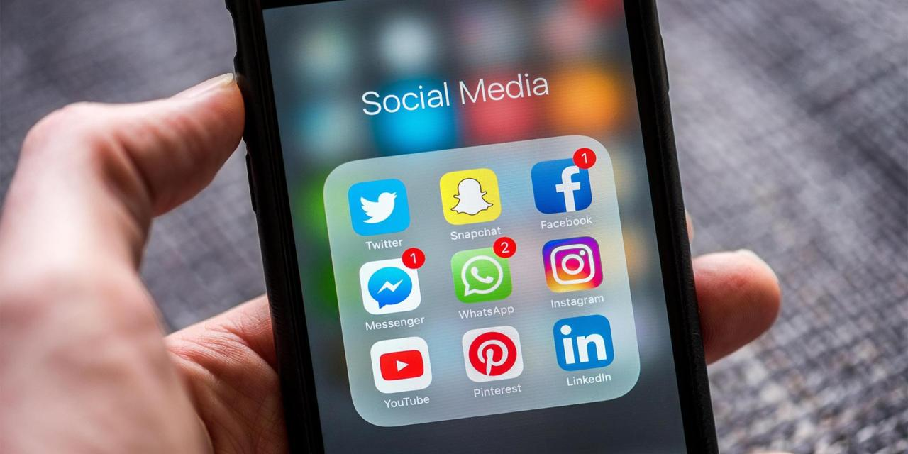

Slide 45
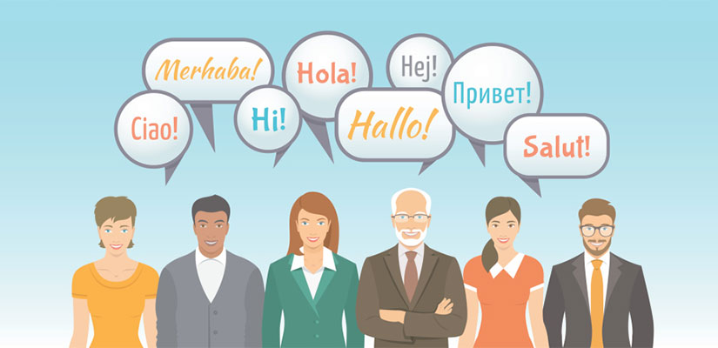
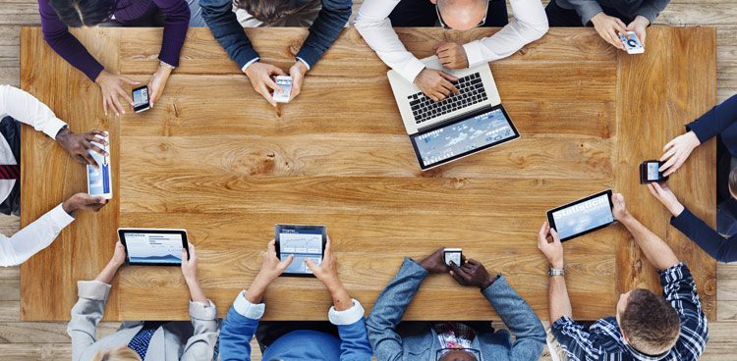
How do people communicate nowadays?

Slide 46
What is the purpose of the text?

Slide 47
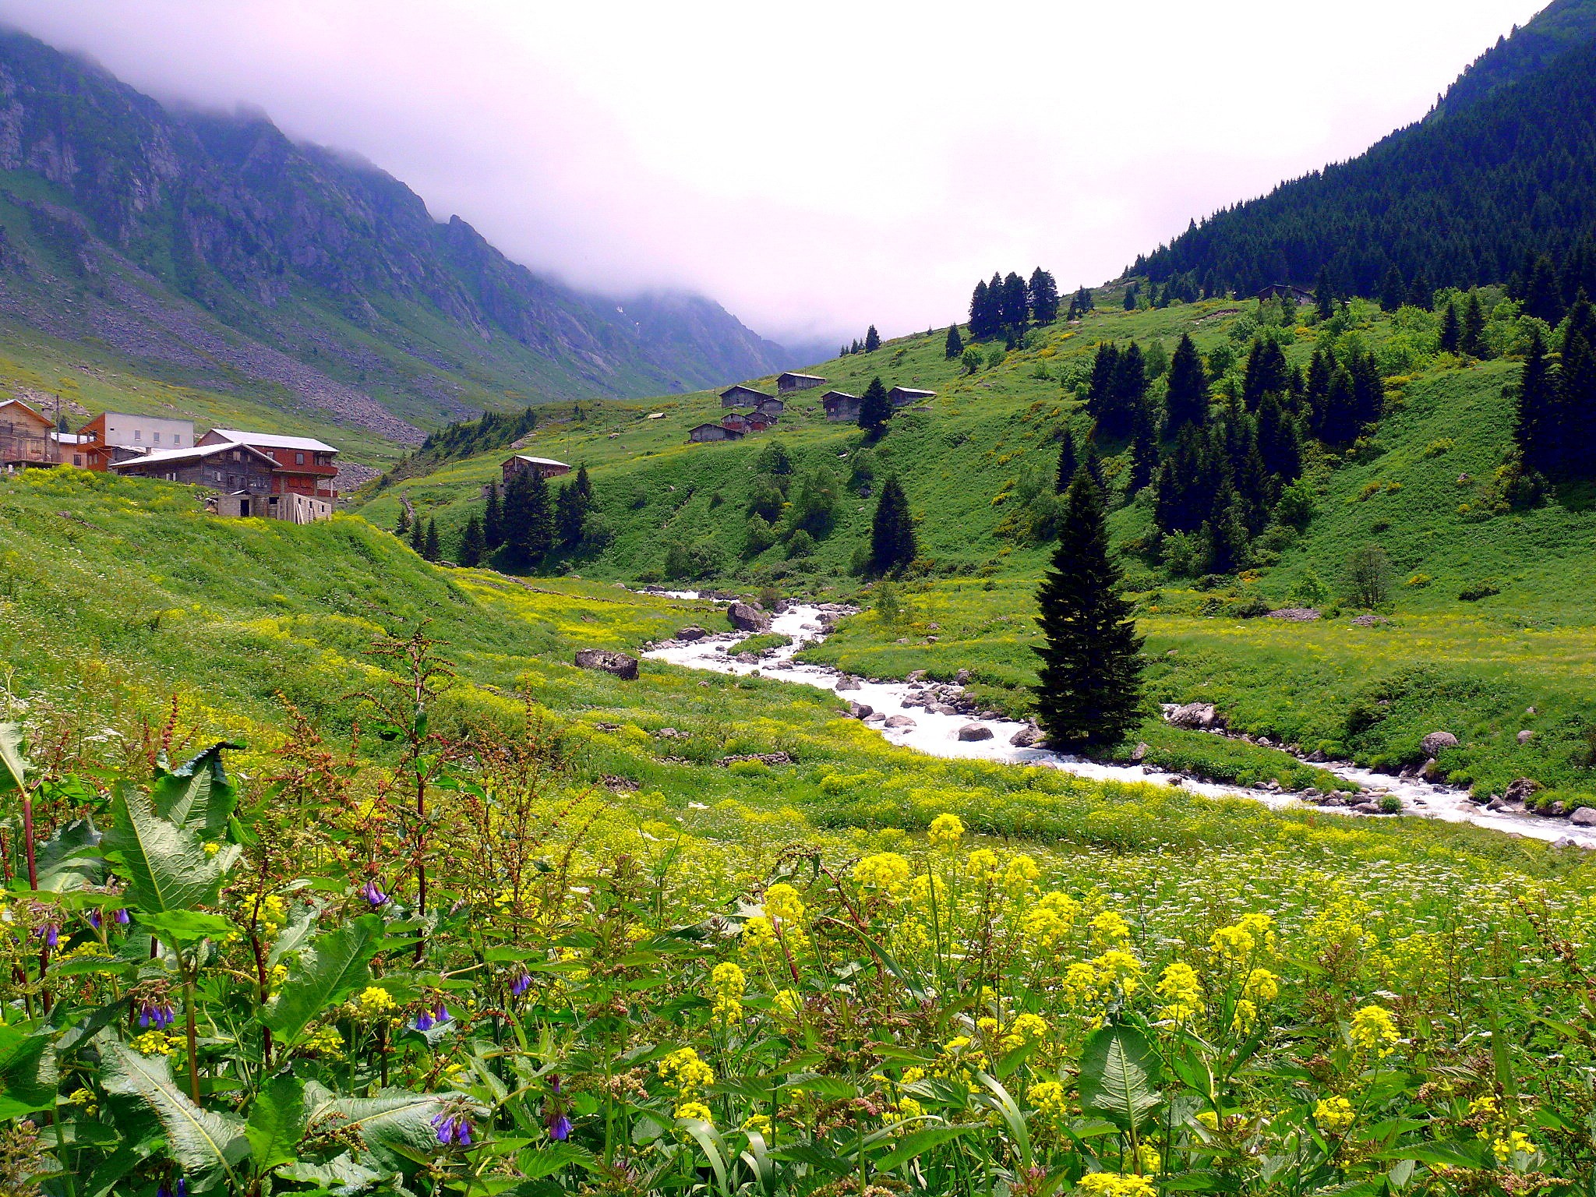
Closure

Slide 48
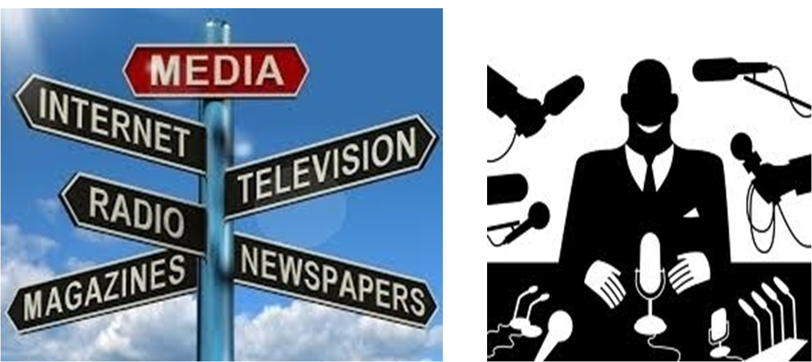
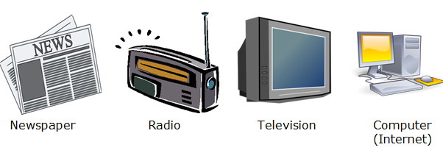
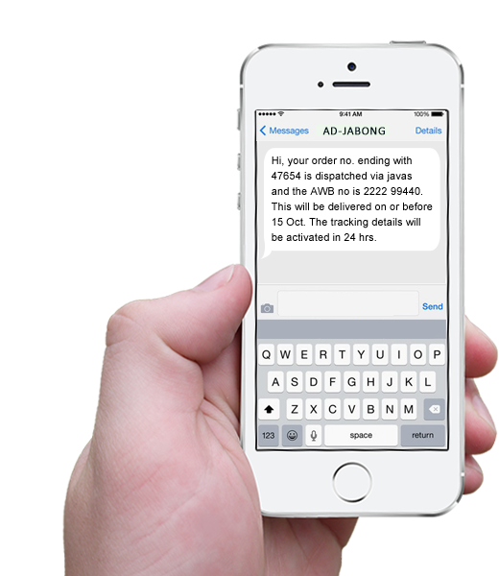
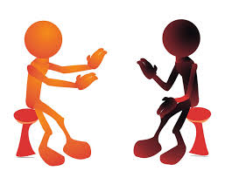
Design a poster about the development of communication.

Slide 49
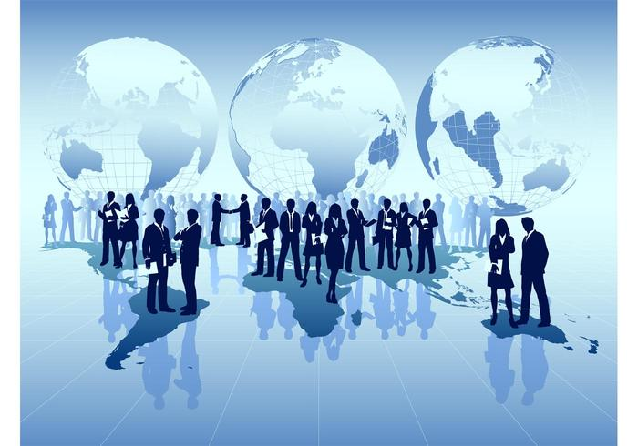
Thank you

